Slide 1
Employee Retention Predictor
- By Pritam Das

Slide 2
Agenda
Title
Slide No
Objective
Data Source
Technologies used
Methodology
Model Evaluation
Model performance Comparison
Final model performance
Streamlit web app
Conclusion
Future scope
3
4
5
6
7
8
9
10
11
12

Slide 3
Objective
Analyze factors leading to employee attrition.
Predict which employees are at risk of leaving.
Provide insights to improve employee retention strategies.

Slide 4
Data Source
Dataset:
hr_employee_churn_data.csv
Contains employee information like:
Employee Satisfaction (Satisfaction Level, Last Evaluation)
Working and Salary Status (Average Monthly hours, No of Project, Salary)
Attrition status (Left)
Click to download dataset

Slide 5
Technologies Used
Python: For app interface
Jupyter Notebook: For model development
Machine Learning: Logistic Regression, Ridge Classification, Decision Trees, Random Forest, Gradient Boosting, Ada Boosting, XgBoost, Catboost, LightGBM, Support Vector Machine
Power BI: Data visualization and interactive dashboard
Libraries Used: pandas, numpy, scikit-learn, matplotlib, seaborn, xgboost, catboost, lightgbm, cloudpickle, dill

Slide 6
Methodology
Data Preparation:
Loaded hr_employee_churn_data.csv (employee metrics like satisfaction, evaluation, projects, monthly hours, tenure, promotions, salary).
Removed duplicates, nulls, and irrelevant columns (empid).
Encoded categorical variables (salary, work accident, promotions).
Exploratory Data Analysis (EDA):
Visualized correlations and feature distributions.
Identified key factors influencing employee churn.
Feature Scaling & Preprocessing:
Scaled numeric features using StandardScaler.
Used OneHotEncoder for categorical features.
Applied ColumnTransformer for combined preprocessing.
Model Building & Selection:
Trained multiple models (Gradient Boosting, Random Forest, LightGBM, XGBoost, CatBoost, Logistic Regression, etc.).
Hyperparameter tuning via GridSearchCV with cross-validation.
Selected best model based on accuracy and confusion matrix average → Gradient Boosting.
Deployment:
Combined preprocessing and model into a pipeline.
Integrated with Streamlit app for real-time predictions.
Users can input employee data and get retain/leave prediction with probability.

Slide 7
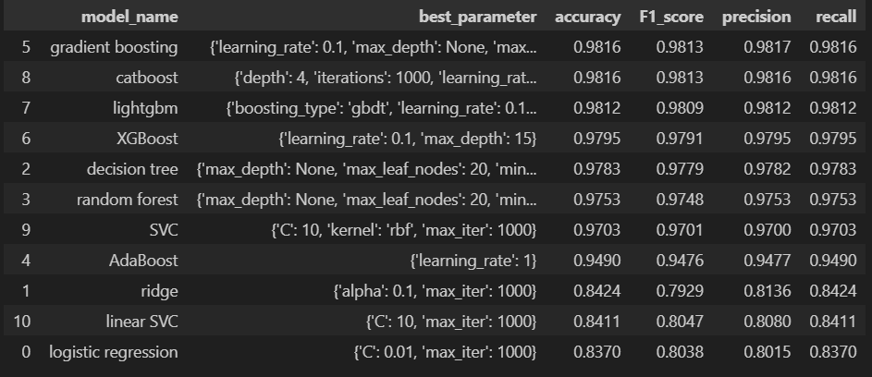
Model Evaluation

Slide 8
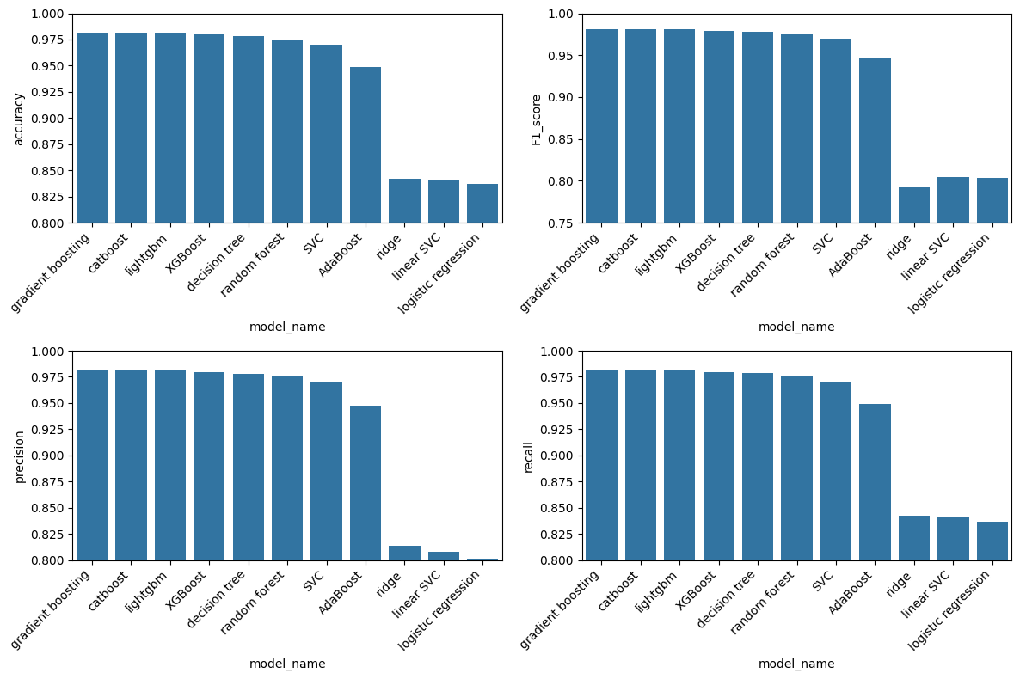
Model Performance Comparison

Slide 9
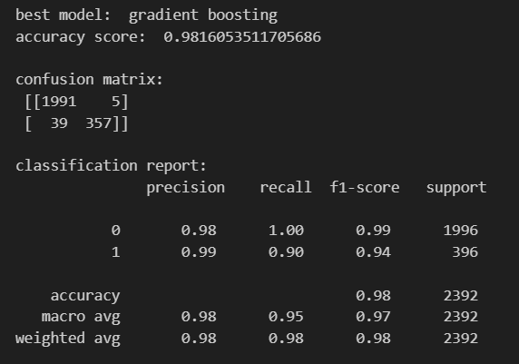
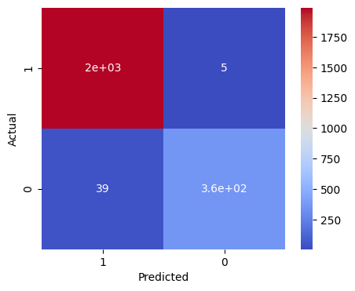
Final Model Performance

Slide 10
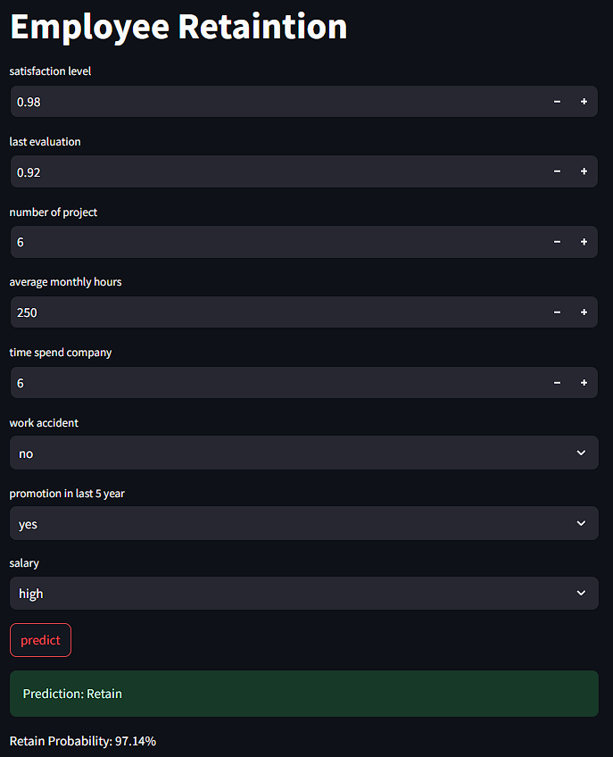
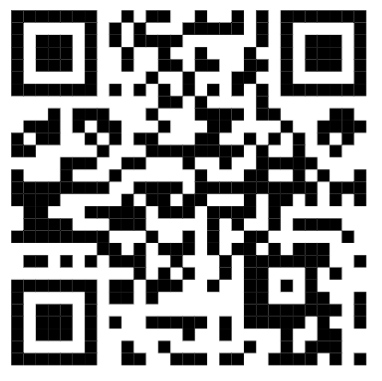
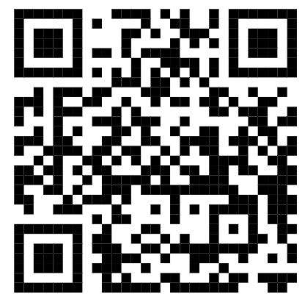
Streamlit Web App
Project Link: pritam2005das/Employee-Retention
Try it live: Employee-Retention

Slide 11
Conclusion
Successfully developed an Employee Retention Prediction System using Machine Learning.
Conducted EDA & model training to identify key factors influencing employee attrition.
Built and deployed an interactive Streamlit app for real-time prediction.
Helps HR teams in early identification of potential attrition and better decision-making.

Slide 12
Future Scope
Enhance model with deep learning for higher accuracy.
Add explainable AI (XAI) to show why an employee may leave.

Slide 13
Questions ?

Slide 14
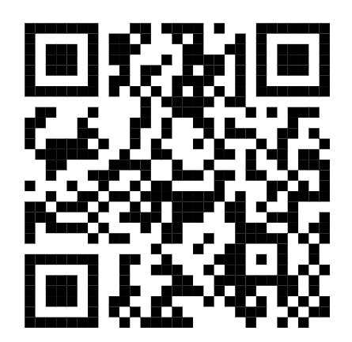
Feedback
Please give me feedback of my project.
Your feedback will encourage and motivate me.
hhh Click here for feedback form

Slide 15
Thank You!

